Slide 1
Stack. Queue.

Slide 2
Stack
Stack is a linear data structure which follows a particular order in which the operations are performed. The order may be LIFO(Last In First Out) or FILO(First In Last Out). Mainly the following three basic operations are performed in the stack:
Push: Adds an item in the stack. If the stack is full, then it is said to be an Overflow condition.
Pop: Removes an item from the stack. The items are popped in the reversed order in which they are pushed. If the stack is empty, then it is said to be an Underflow condition.
Peek or Top: Returns top element of stack.
isEmpty: Returns true if stack is empty, else false.

Slide 3
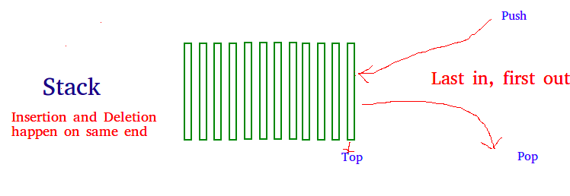

Slide 4
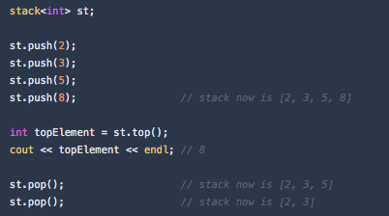
There is a built-in stack in most languages. In most cases, you should use it when solving interview questions:

Slide 5
Time Complexities of operations on stack:
push(), pop(), isEmpty() and peek() all take O(1) time. We do not run any loop in any of these operations.

Slide 6
Queue
A Queue is a linear structure which follows a particular order in which the operations are performed. The order is First In First Out (FIFO). A good example of a queue is any queue of consumers for a resource where the consumer that came first is served first. The difference between stacks and queues is in removing. In a stack we remove the item the most recently added; in a queue, we remove the item the least recently added.

Slide 7
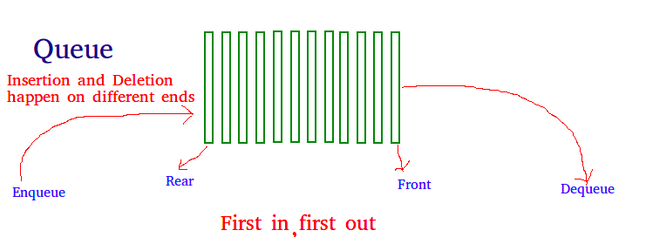

Slide 8
Applications of Queue Data Structure
Queue is used when things don’t have to be processed immediately, but have to be processed in First In First Out order like Breadth First Search. This property of Queue makes it also useful in following kind of scenarios.
1) When a resource is shared among multiple consumers. Examples include CPU scheduling, Disk Scheduling.
2) When data is transferred asynchronously (data not necessarily received at same rate as sent) between two processes. Examples include IO Buffers, pipes, file IO, etc.

Slide 9
Deque
Deque or Double Ended Queue is a generalized version of Queue data structure that allows insert and delete at both ends.
Operations on Deque: Mainly the following four basic operations are performed on queue:
insertFront(): Adds an item at the front of Deque.
insertLast(): Adds an item at the rear of Deque.
deleteFront(): Deletes an item from front of Deque.
deleteLast(): Deletes an item from rear of Deque.
In addition to above operations, following operations are also supported getFront(): Gets the front item from queue. getRear(): Gets the last item from queue. isEmpty(): Checks whether Deque is empty or not. isFull(): Checks whether Deque is full or not.

Slide 10
Applications of Deque:
Since Deque supports both stack and queue operations, it can be used as both. The Deque data structure supports clockwise and anticlockwise rotations in O(1) time which can be useful in certain applications. Also, the problems where elements need to be removed and or added both ends can be efficiently solved using Deque. For example see Maximum of all subarrays of size k problem., 0-1 BFS and Find the first circular tour that visits all petrol pumps.

Slide 11
Priority Queue
Priority queue is a data structure that supports at least the following operations:
Insert an element in the queue in O(logN) time (where N is the size of the queue).
Find the largest (or the smallest) element in the queue in O(1) time.
Remove an element from the queue in O(logN) time.

Slide 12
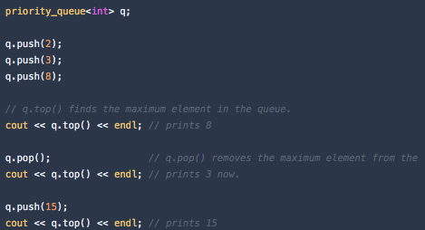

Slide 13
